Slide 2
The new PRO-Series – APPs inclusive
Functional expansion of the Janitza measurement devices through in-house APPs
Easier interpretation and analysis of measurement data, e.g. through the integrated traffic-light principle for the PQ status
Presentation of the APPs available and their functions via the APP management
Redundancy – 100% security for your measured data in the device memory
The most important information at a glance through QR code

Slide 3
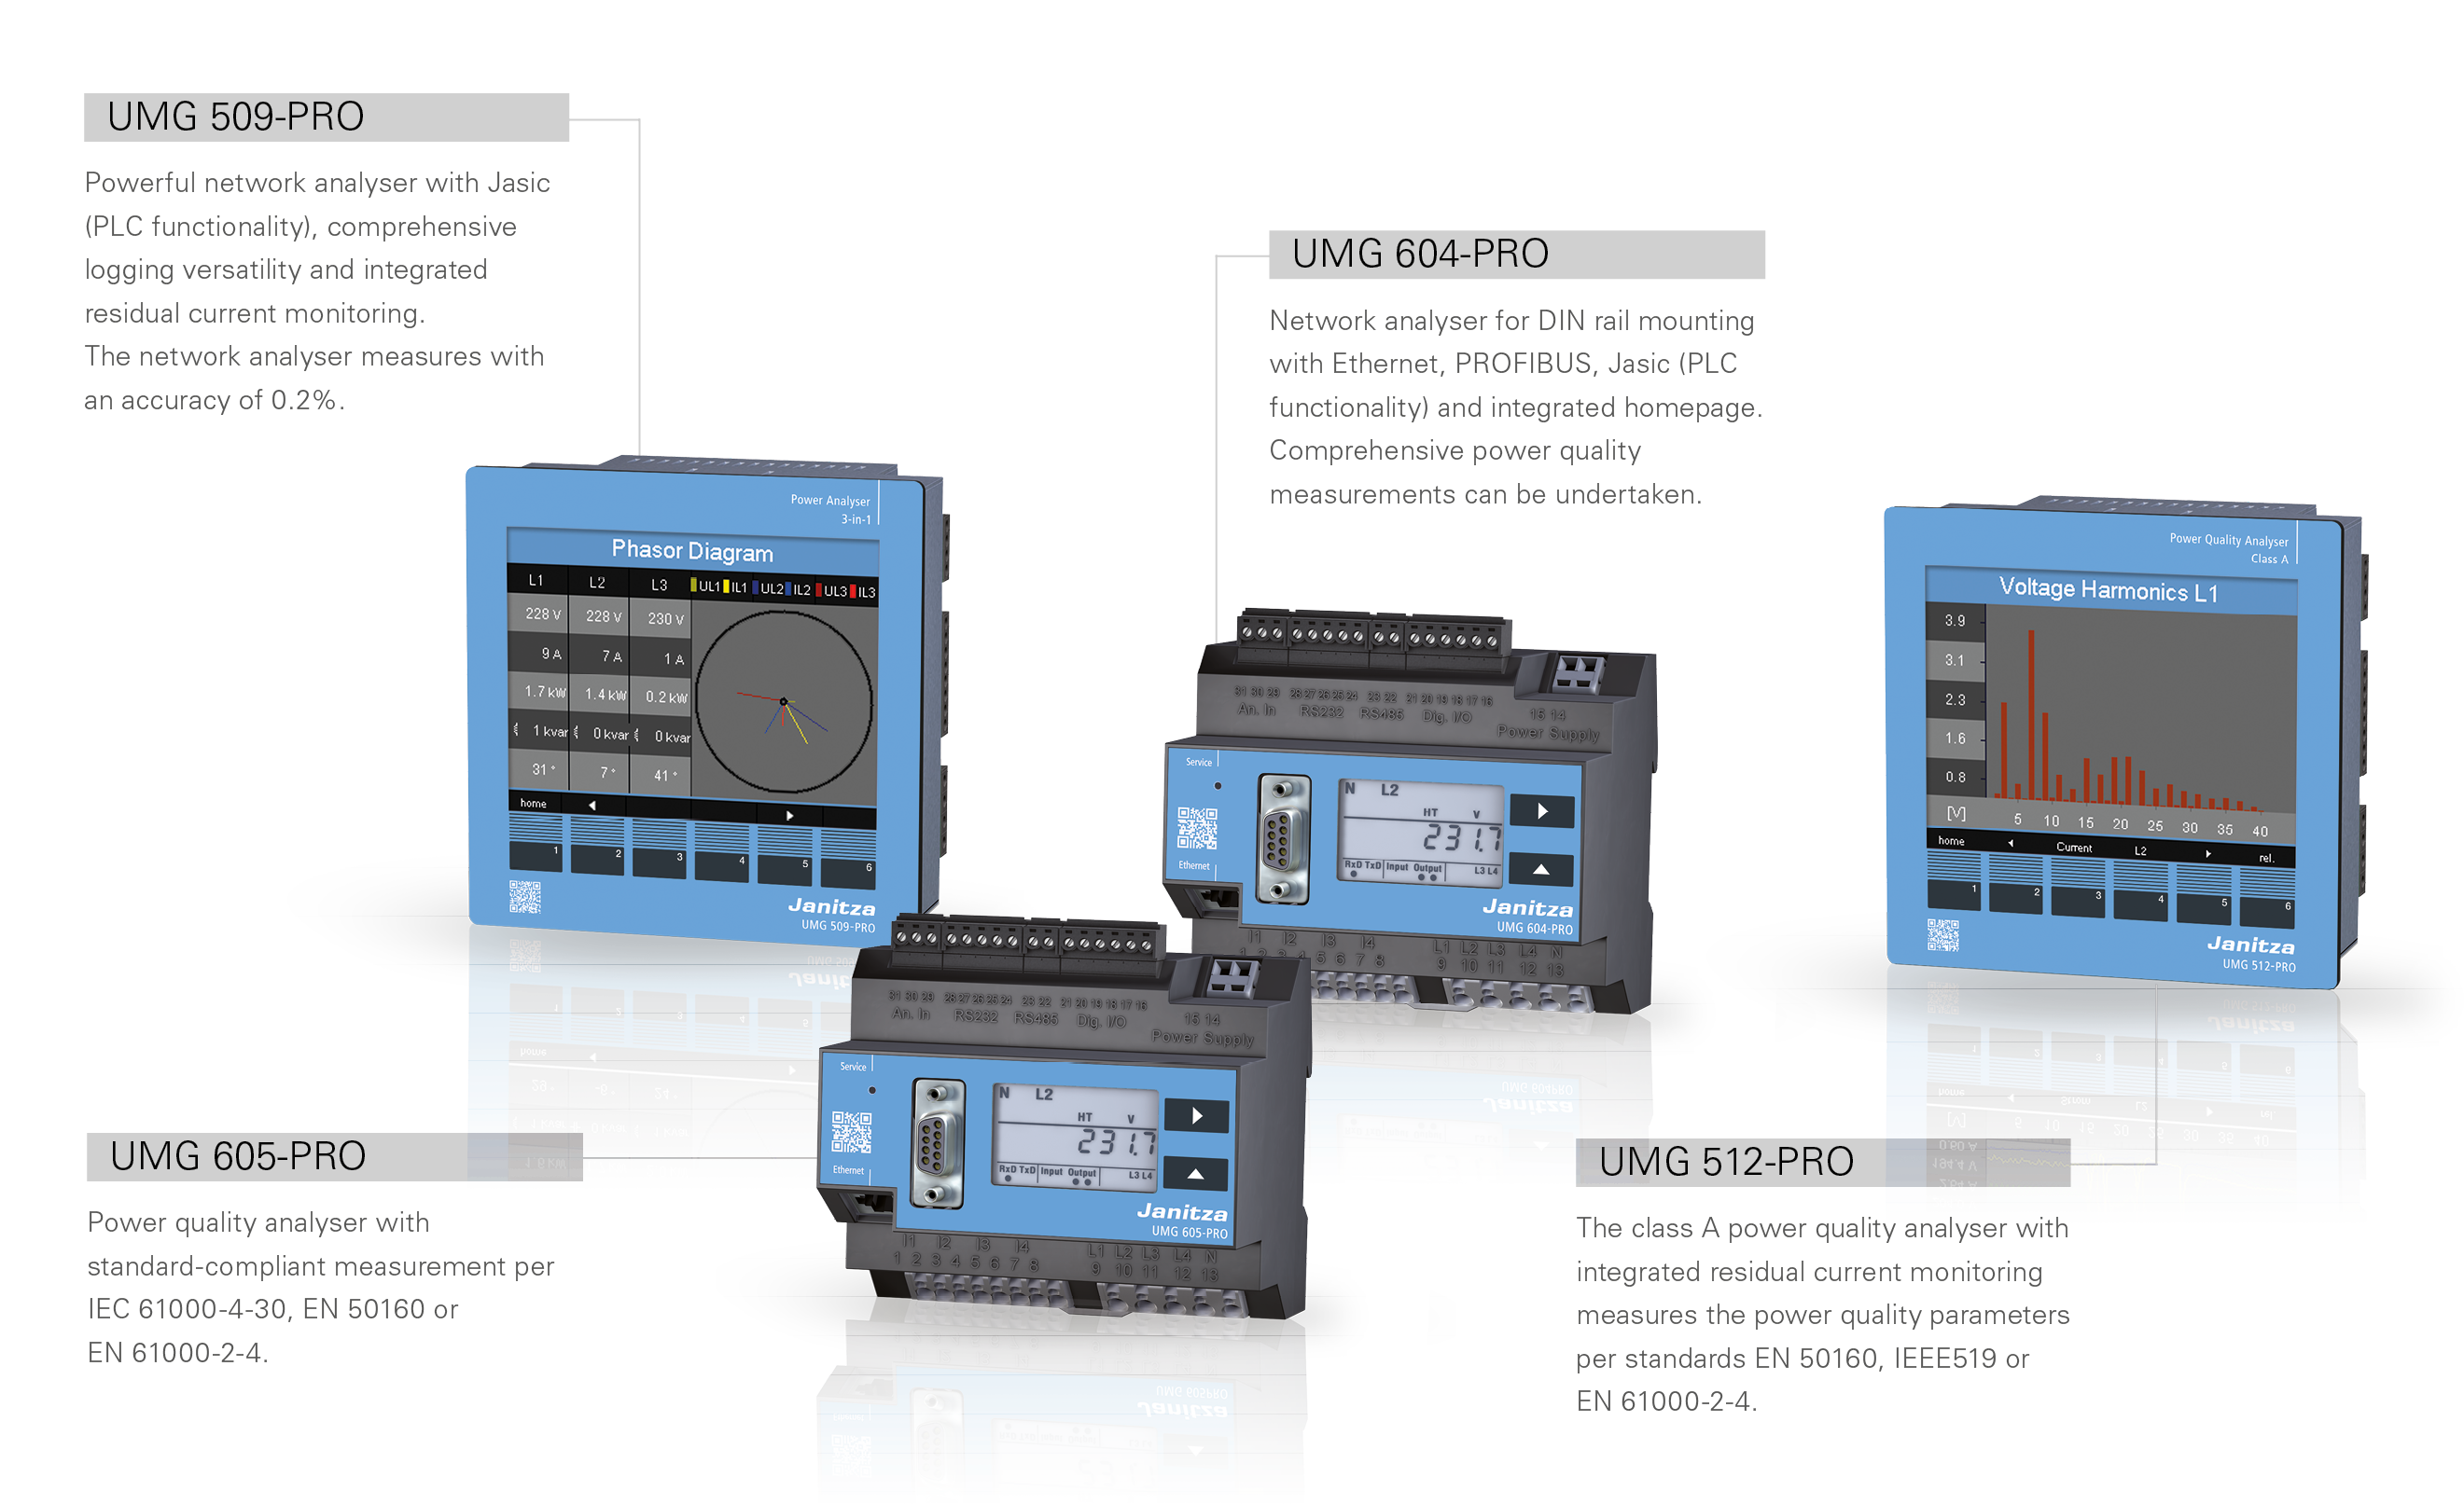
The new PRO series combines the latest technology with excellent functions and attractive design

Slide 4
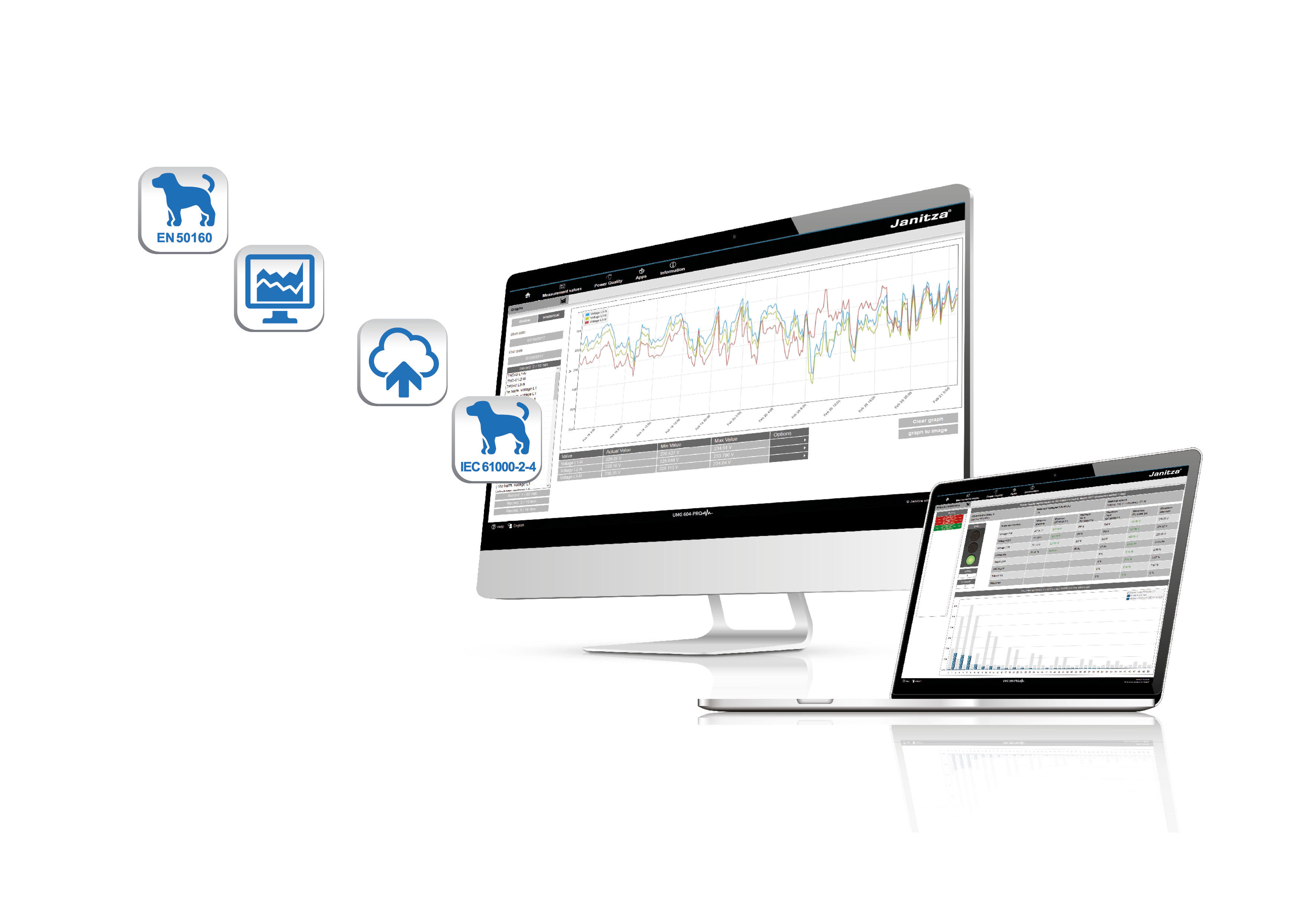
Data can be processed, visualised and analysed with the help of the pre-installed Janitza APPs.

Slide 5
Functional expansion through 4 preinstalled APPs
Measurement monitor
EN 50160 Watchdog
IEC 61000-2-4 Watchdog
Push service
All APPs can be transferred with the device manager (constituent part of GridVis®) and via Ethernet-connected devices – to just one device or to multiple measurement devices simultaneously.
The APPs expand, for example, the analysis and visualisation
tools, with which voltage events per “IEC 61000 -2-4” and
“EN 50160” can be analysed and reproduced on the device's
own homepage.

Slide 6
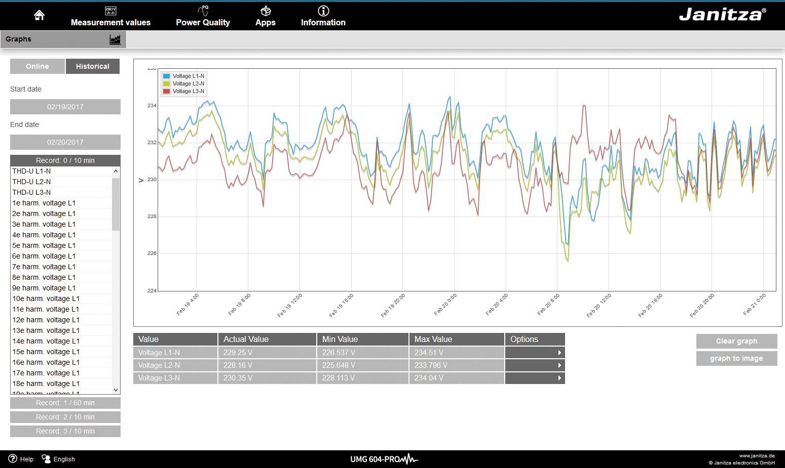
Measurement monitor
Configurable display of current and historical measured values with automatic scaling. Graphical representation on the device's own homepage without additional software installation.
Your benefits:
Access to current and historical measured values
Display with scalable timebase
Quick and easy operation with “drag & drop”
Web-based solution without additional software installation
Can be called up on different devices such as PC, Laptop, Tablet and Smartphone

Slide 7
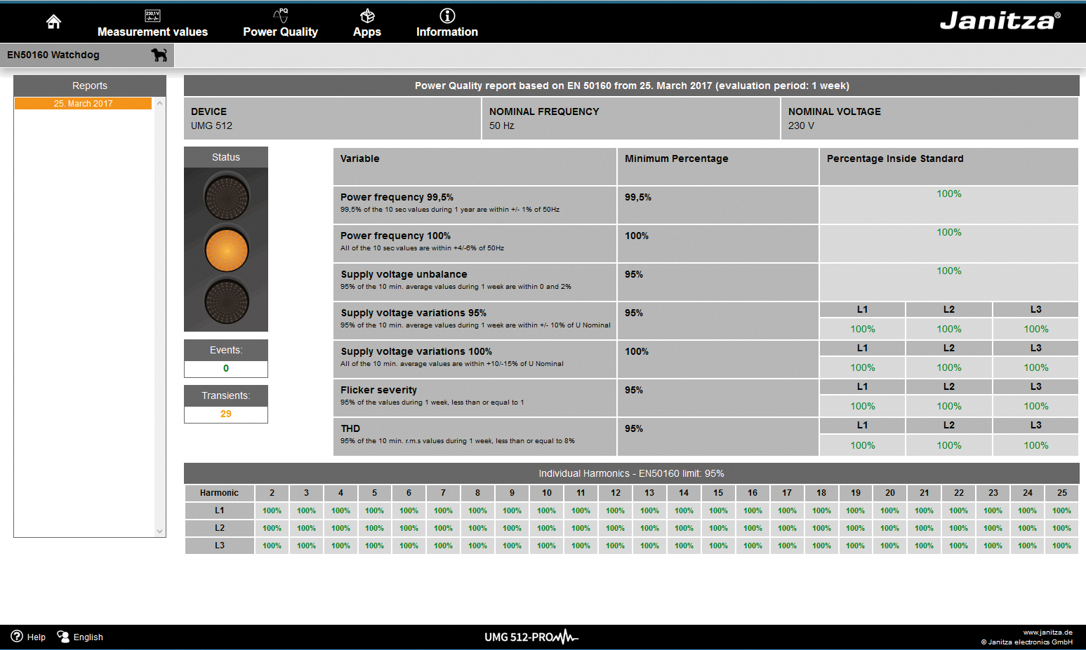
EN 50160 Watchdog
Permanent monitoring of the power quality per EN 50160
in energy supply networks.
Your benefits:
Integrated watchdog function for automatic standard interpretation and threshold value monitoring (per EN 50160)
Local data analysis – No need to transmit large volumes of measured data from the measurement device to a host system
Network quality analysis possible even without comprehensive PQ knowledge
Rapid detection of events that do not comply with the quality agreements
Standard-compliant and continuous monitoring and ‘incoming goods’ checks of the energy supply

Slide 8
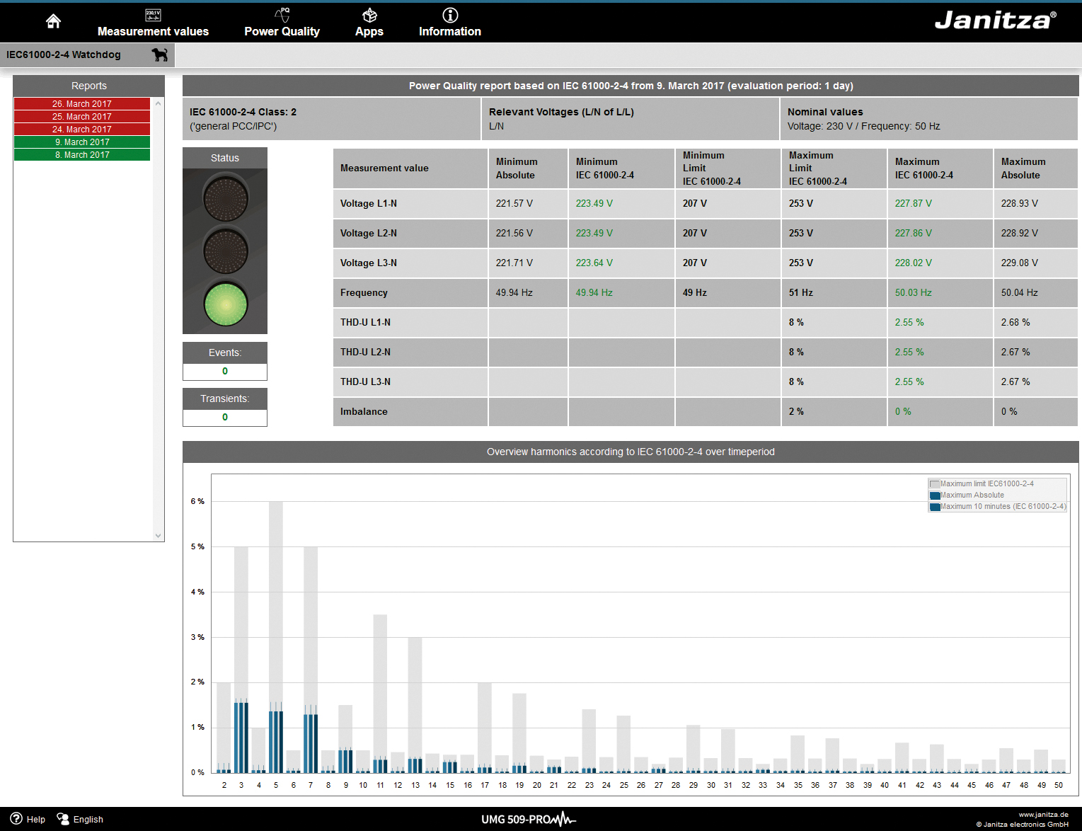
IEC 61000-2-4 Watchdog
Permanent monitoring of the power quality per EC 61000-2-4
in customers' energy supply networks.
Your benefits:
Integrated watchdog function for automatic standard interpretation and threshold value monitoring
No need to transmit large volumes of measured data from the measurement device to a host system
Network quality analysis without comprehensive PQ knowledge
Rapid detection of events that do not comply with the quality agreements
Standard-compliant and continuous monitoring to protect company's own installed systems

Slide 9
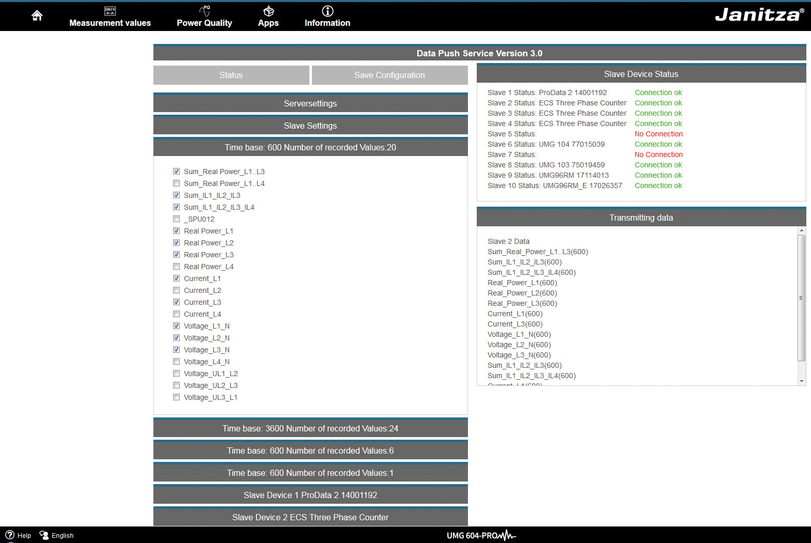
Push service
Automatic transmission of measurement data directly from the measurement device in a Cloud service
Your benefits:
Transmission of measurement data directly from the measurement device to a Cloud or portal solution selected by the customer, without additional hardware or software
Data can be called up online throughout the world via the Cloud
Cost-effective and convenient user solution
Synchronous acquisition of measured values from different locations
Avoidance of data gaps in the event of network connections being lost, through the use of buffer times
Data security through communication via standardised HTTP port (port 80)

Slide 10
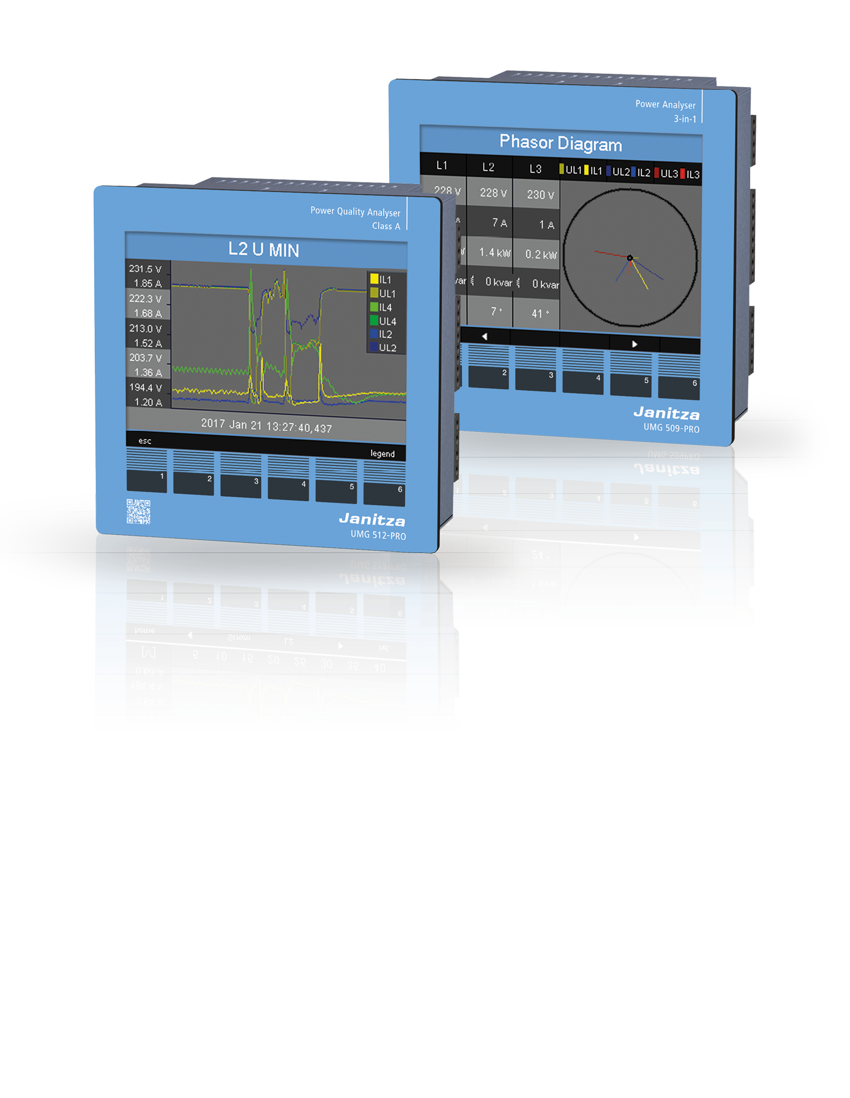
UMG 509-PRO & UMG 512-PRO
Multifunctional power quality analysers with residual current monitoring
High-performance power quality analysers
Class A certified (UMG 512-PRO)
Integrated residual current monitoring (RCM measurement)
High accuracy of measurement
Can be used in a great variety of network types
Multiple interfaces and open communication architecture with numerous protocols (Modbus, IP) for simple integration into superordinate systems
Inclusive thermistor input and two digital inputs and outputs each
256 MB integrated measurement data memory for redundant and
securemeasurement data acquisition
Display of current and historical measurement data via the
device homepage as well as parameterising and assessment
software GridVis® Basic
Integrated watchdog function as web-based visualisation
Power quality monitoring without specialist knowledge
Threshold value monitoring by means of traffic-light principle
Graphical programming: Jasic (PLC functionality)

Slide 11
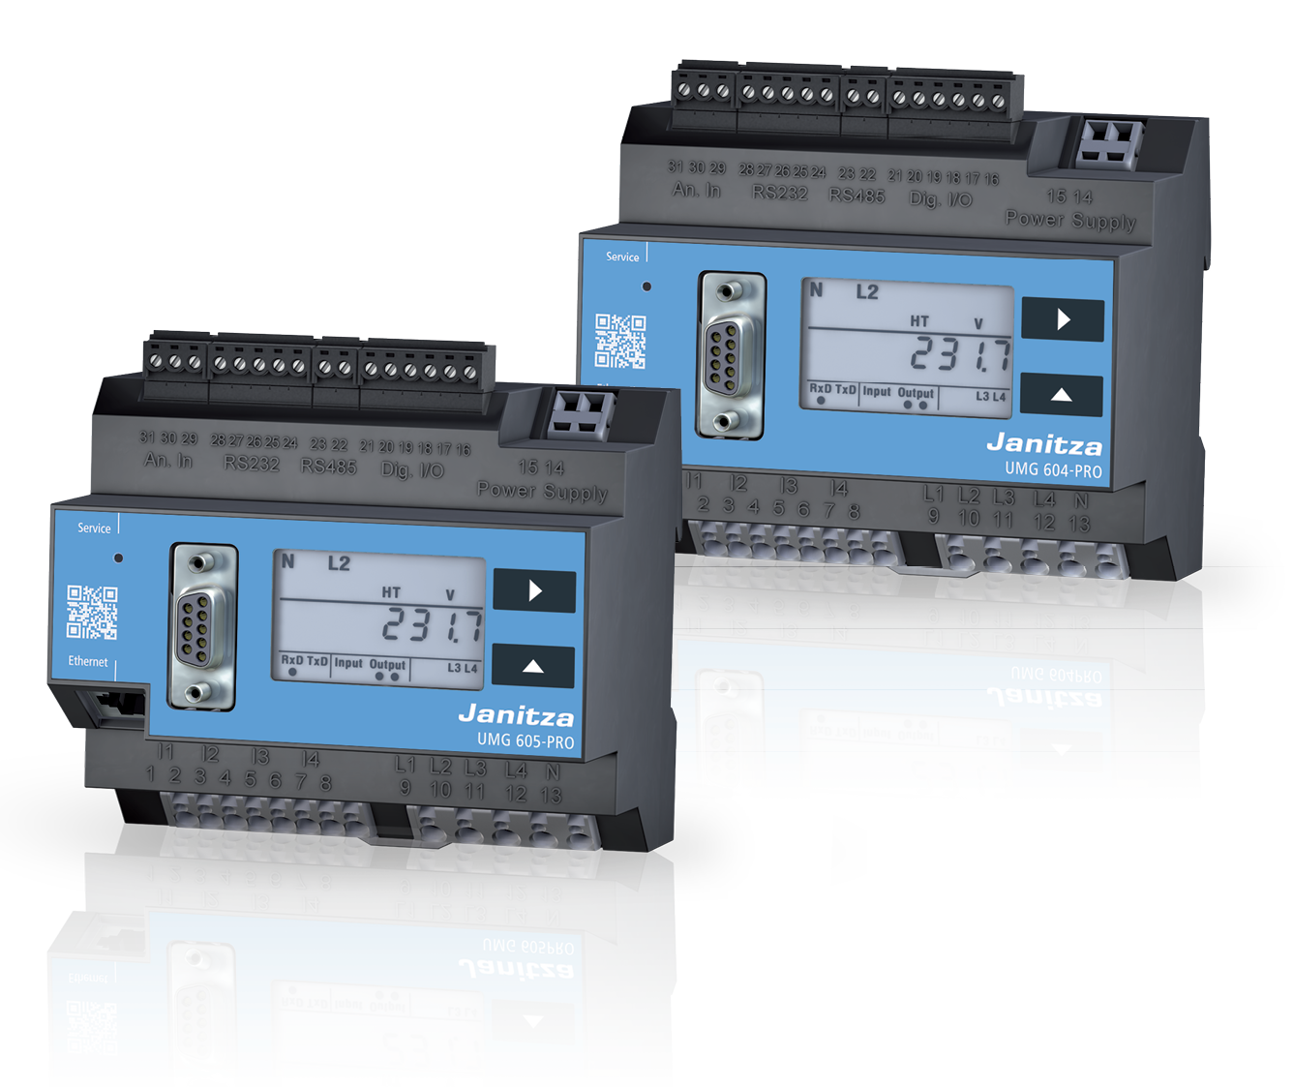
UMG 604-PRO & UMG 605-PRO
Network quality analysers for DIN rail mounting
High-performance network quality analysers for DIN rail mounting
Power quality measurement in accordance with standards DIN EN 50160 and DIN EN 61000 -2-4
High accuracy of measurement
Can be used in a great variety of network types
Multiple interfaces and open communication architecture with numerous protocols (Modbus, IP) for simple integration into superordinate systems
Including thermistor input
128 MB measurement data memory for redundant and secure measurement data
acquisition
Display of current and historical measurement data via the device homepage as
well as parameterising and assessment software GridVis® Basic
Integrated watchdog function as web-based visualisation
Power quality monitoring without specialist knowledge
Threshold value monitoring by means of traffic-light principle
Graphical programming: Jasic (PLC functionality)

Slide 12
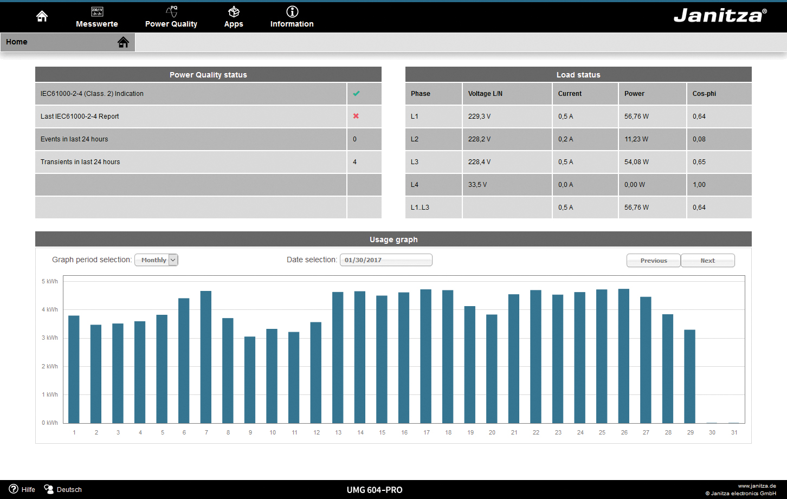
Device homepage
Assessment available at all times

Slide 13
Device homepage
Your benefits
Access to powerful device homepage via web browser
Constant availability of the measurement data
No software installation necessary
Online data, historical data etc. can be called up directly via the device homepage
Function expansion possible through APPs
Remote operation of the device display via the homepage
Integrated PQ watchdog
Hyperlinks deliver more detailed information
Integrated measured value monitor
Overview of events and transients in the network
Convenient selection of the calculation mode for displaying the measurement data per standard IEC 61000-2-4 or EN 50160**
* Applies to UMG 605 and UMG 512

Slide 14
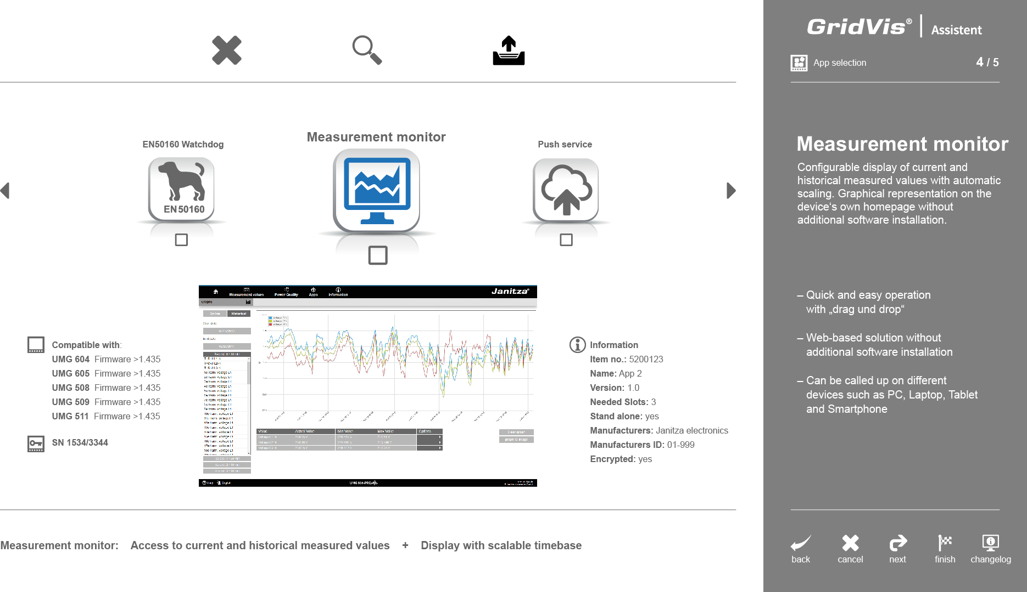
NEW: GridVis® APP Management
Manage APPs quickly and conveniently

Slide 15
NEW: GridVis® APP Management
With the new APP management, which is a constituent component of the GridVis® device manager, users have the ability to expand and enhance functions – unique flexibility.
Your benefits
Simple and convenient installation and removal of APPs
Preview with information and images from the respective APP
APPs are available free-of-charge in GridVis®, ready for download
Upload and installation of customer-specific APPs

Slide 16
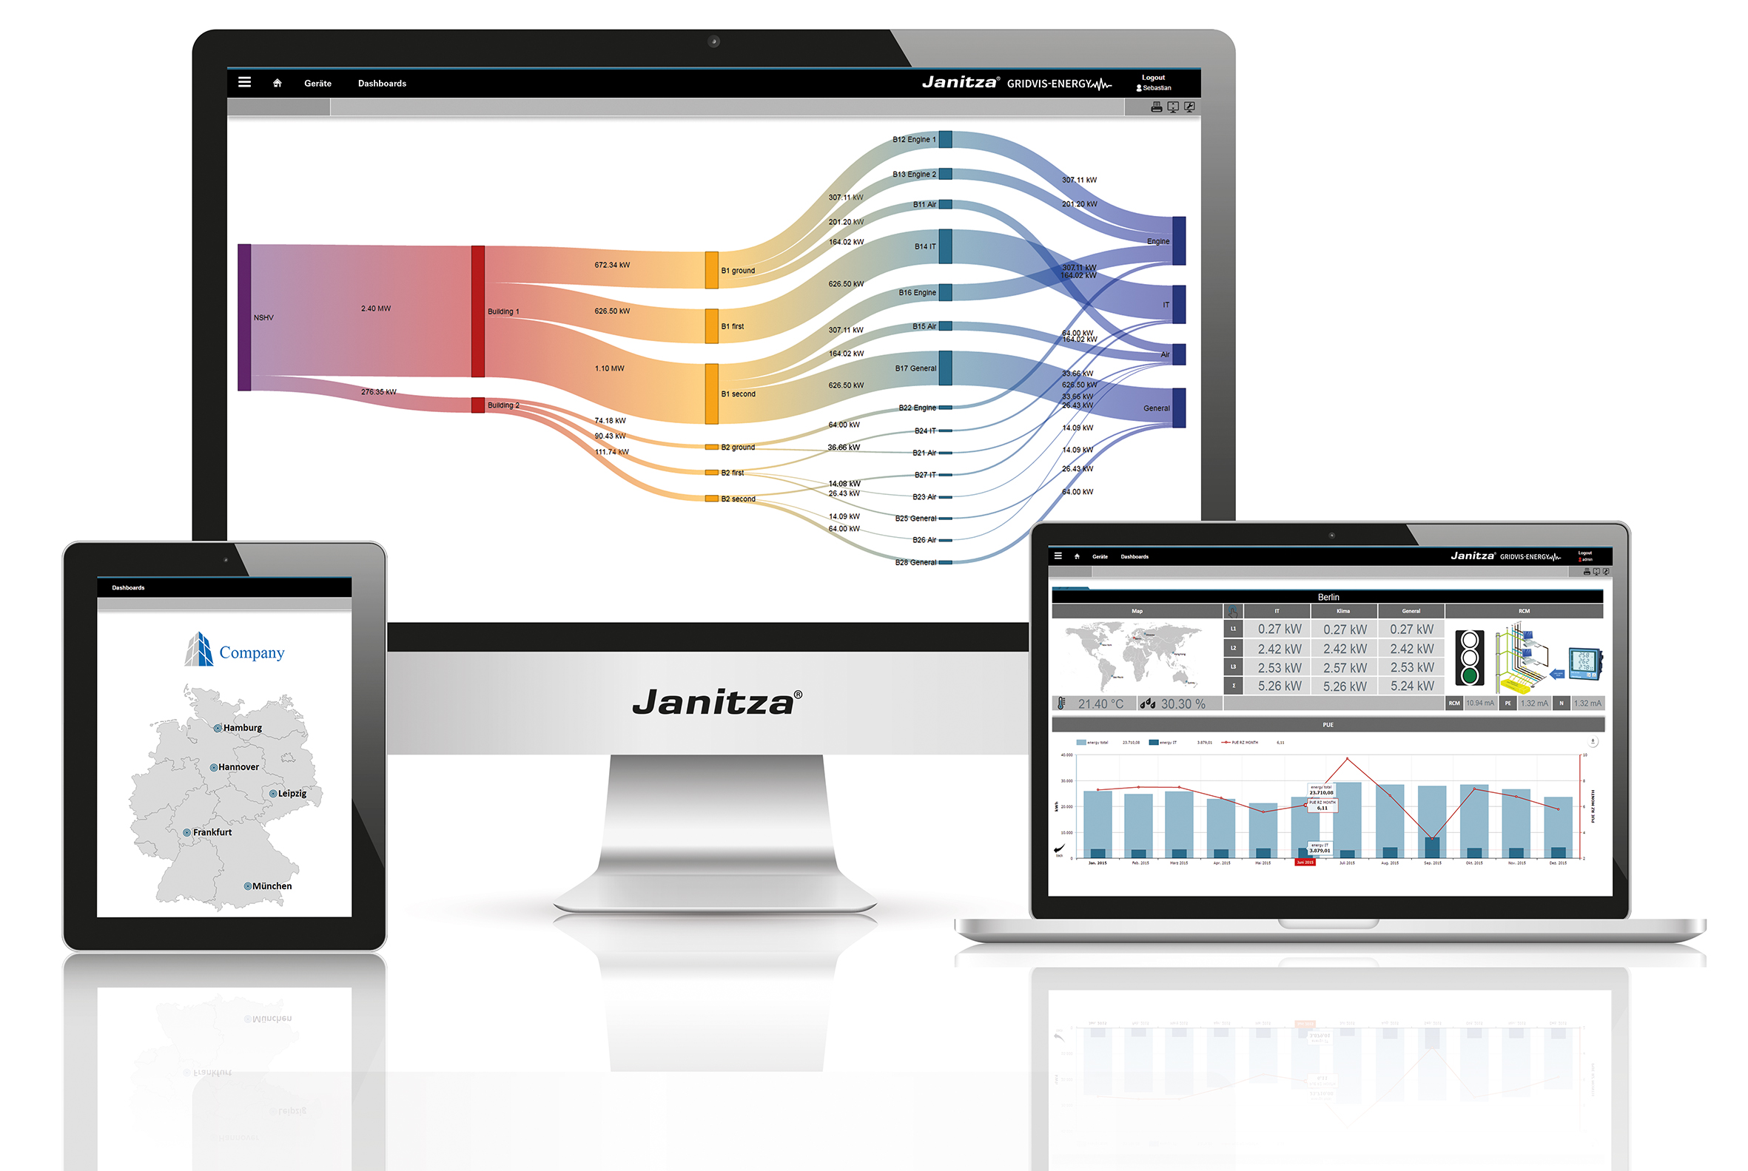
GridVis® Visualisation Software

Slide 17
GridVis® Visualisation Software
Your benefits
Configuration of the measurement system and the UMG measurement devices
Certified ISO 50001 Energy management software
Automatic or manual readout of measurement data
Graphical illustration of current and historical measurement data
Comprehensive alarm management
User management
Generic Modbus devices, virtual meters
Graphic user interface (topological view) for visualising real-time data and messages
Minimum, average and maximum values displayed in a graph
Statistical evaluation of the measured data
Comprehensive export functions (e.g. Excel)
Reports for energy usage and power quality (EN 50160, IEEE 519, EN 61000-2-4) manual or time-controlled with individual schedule
Saving the data in a central database including database management (e.g. MySQL / MS SQL / Derby / Janitza database)

Slide 19
Imprint

